Slide 1
DEEP CONVOLUTIONAL NEURAL NETWORK MODEL TO PREDICT CHEST OPACITY IN IMAGES
Presented by -
Ssenoga Badru:
Reg. No.: 2022/HD05/1470U
Student No.:2200701470
Email:ssenoga.badru@students.mak.ac.ug
Affiliation: Makerere University Uganda

Slide 2
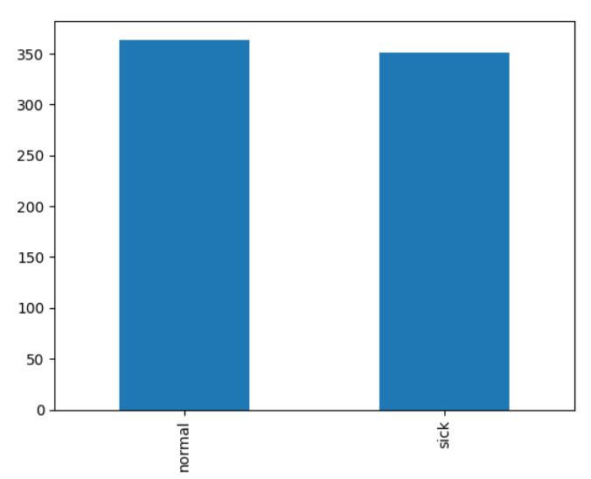
EDA : DISTRIBUTION OF TARGET VARIABLES

Slide 3
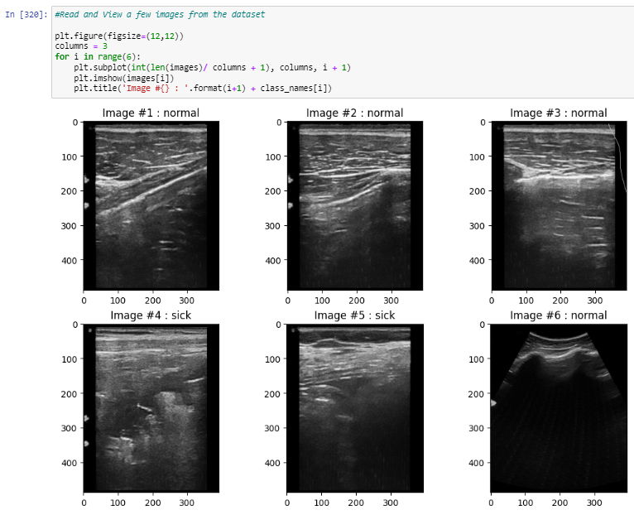
VIEW IMAGES

Slide 4
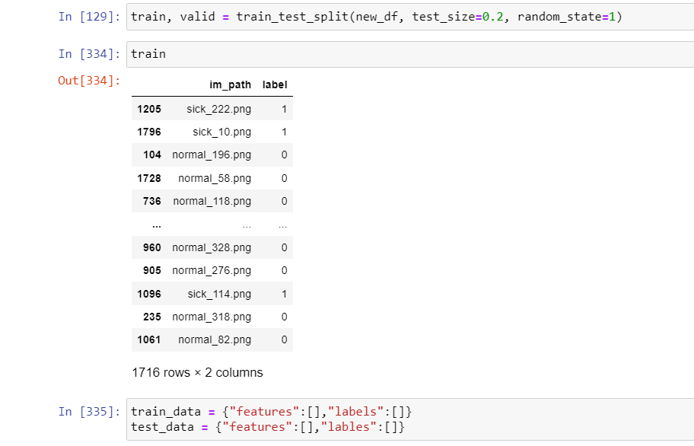
PREPARE DATASET AND TRAIN

Slide 5
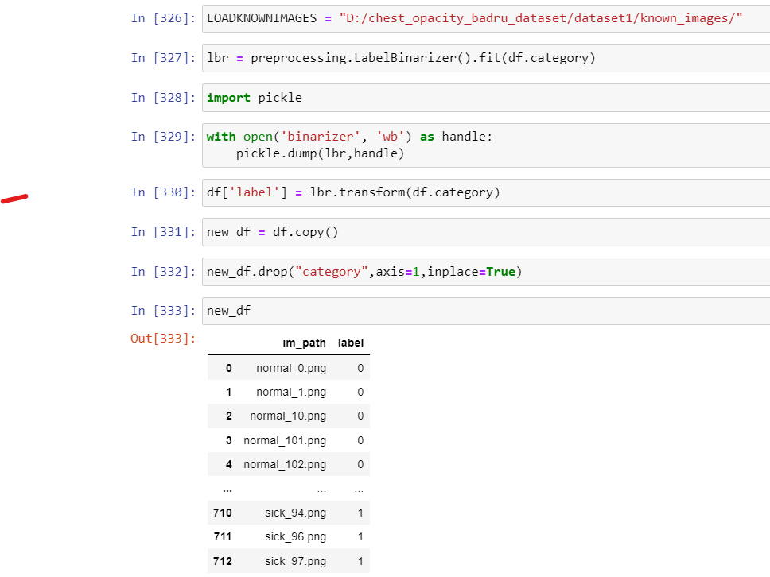
DATA PREPROCESSING

Slide 6
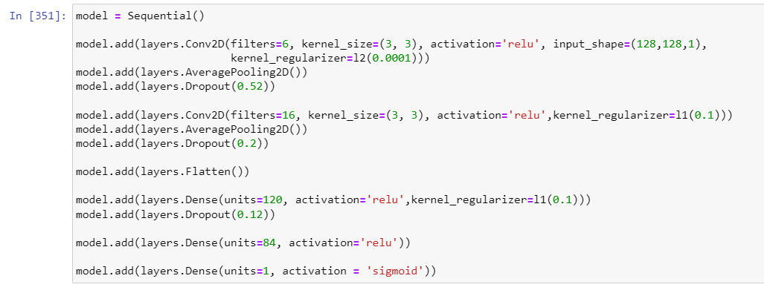
HYPERPARAMETERS

Slide 7
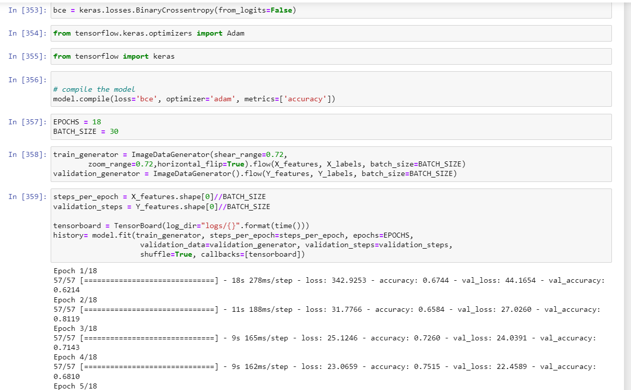
PREPARE DATASET AND TRAIN

Slide 8
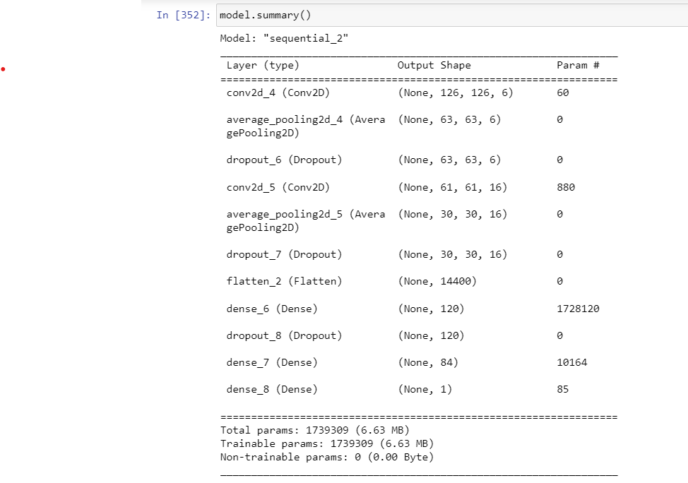
MODEL SUMMARY

Slide 9
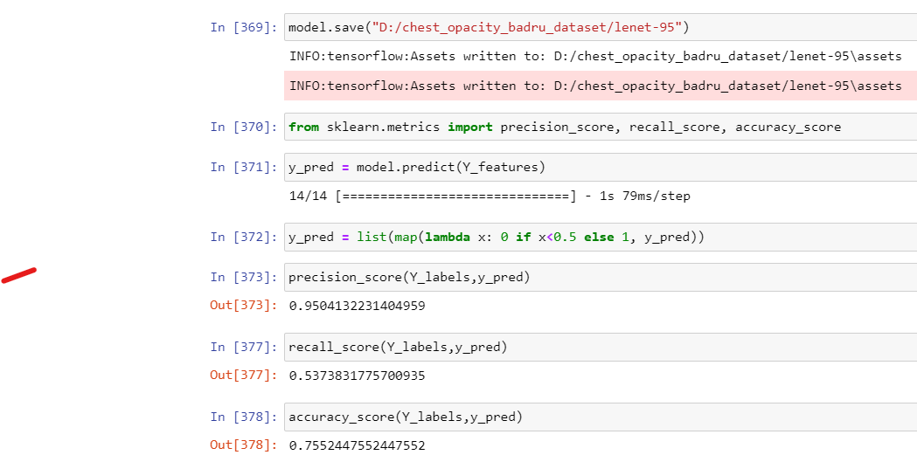
SAVED MODEL

Slide 10
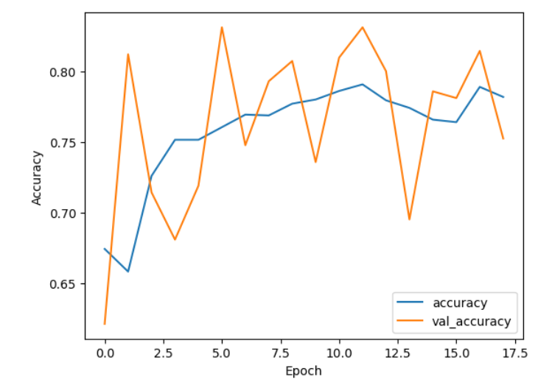
RESULTS - TRAINING AND VALIDATION (ACCURACY)

Slide 11
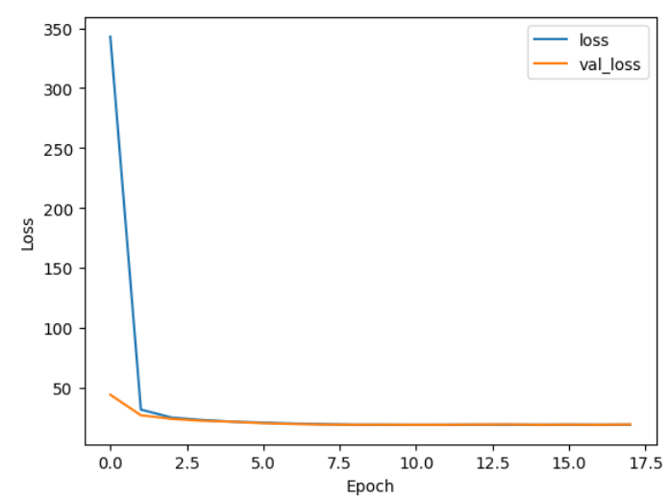
RESULTS - TRAINING AND VALIDATION (LOSS)

Slide 12
RESULTS
DATASET 1 - TEST SET | Accuracy | Precision | Recall
 | 0.75 | 0.95 | 0.53
DATASET 2 | Accuracy | Precision | Recall
 | 0.58 | 0.58 | 0.60

Slide 13
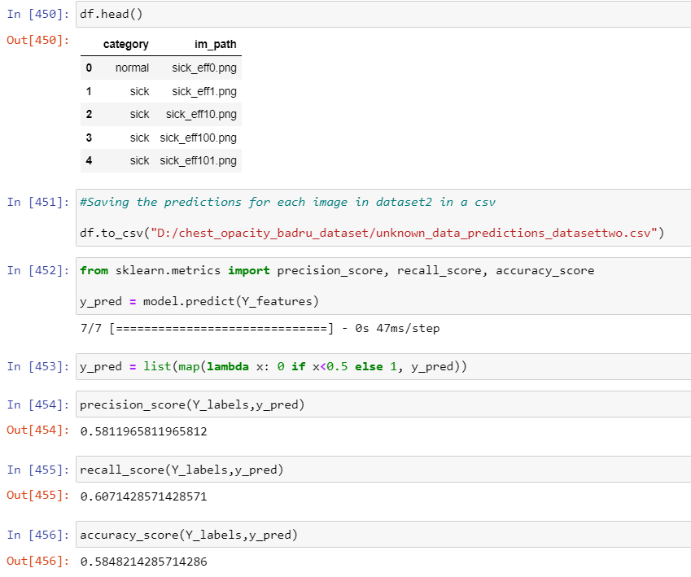
PREDICTIONS FOR DATASET 2 IMAGES

Slide 14
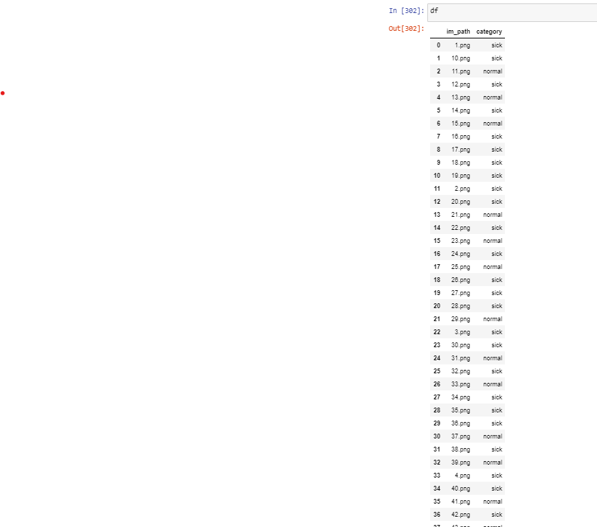
PREDICTIONS FOR UNKNOWN IMAGES
The .csv file with data predictions for unknown images and dataset 2 images are available in the project Zipped file (Google MyDrive link: https://drive.google.com/file/d/10gIvzKVgNvzW9xyaFHayG7nG_GfHz3mK/view?usp=sharing )

Slide 15
The end

